Slide 1

Module 3
Deep Learning: Feed-Forward Architectures
Notes:
Guidelines
Use section headers to chunk content in your presentation.
Use the same style of section header throughout your presentation.
Keep your title to no more than 2 lines.

Slide 2
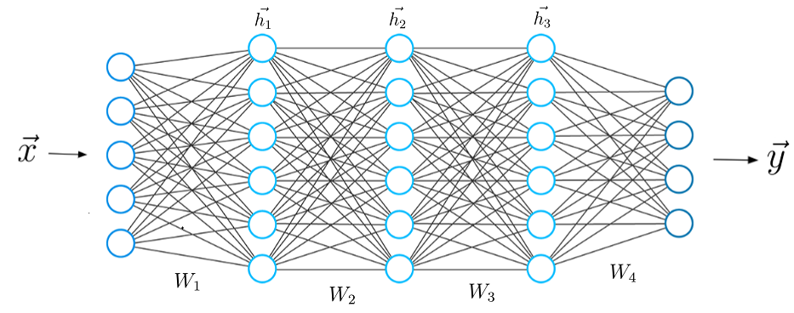
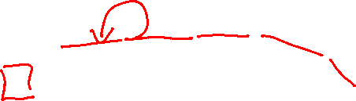
DL: Feed-Forward Architectures
Notes:
Guidelines
Use a title slide at the beginning of your presentation. There are 9 variations of title slides to choose from.
If you will have a series of slideshows, we recommend using the same style of title slide for each presentation.
Keep your title to no more than 2 lines.
Do not change the font style or font size of the title or subtitle.

Slide 3
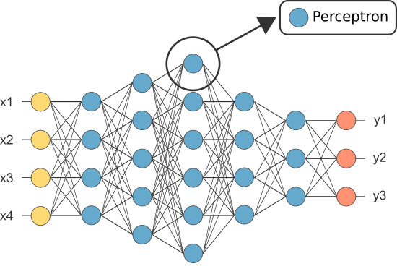
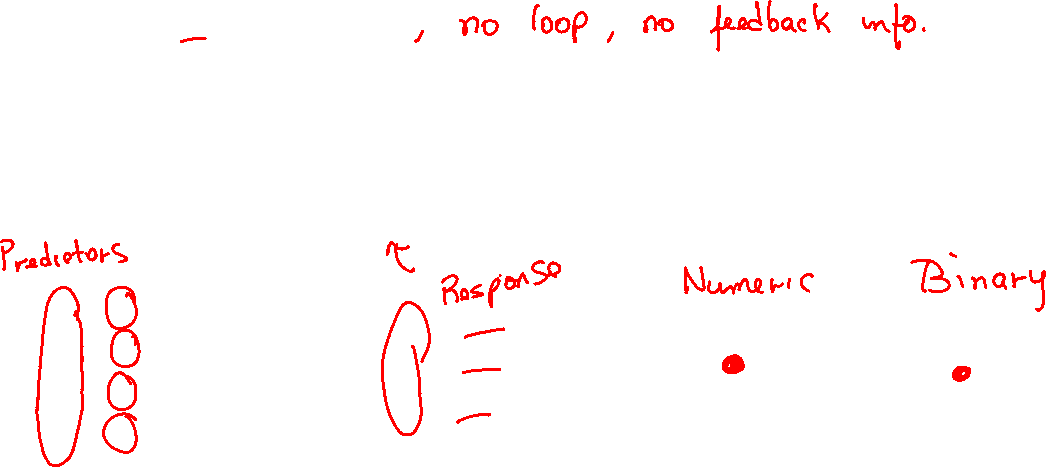
Feed-Forward (MLP) Architecture
Flow is unidirectional
Information flows forward
Input nodes ▻ hidden nodes ▻ output nodes
Composed of neurons (e.g., perceptrons)

Slide 4
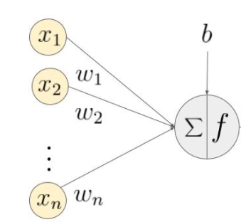
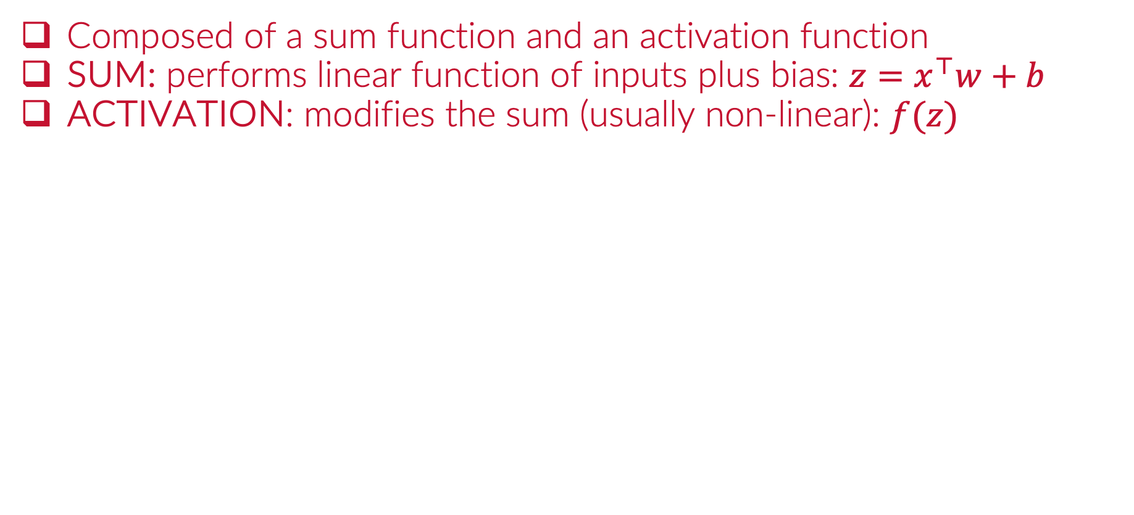
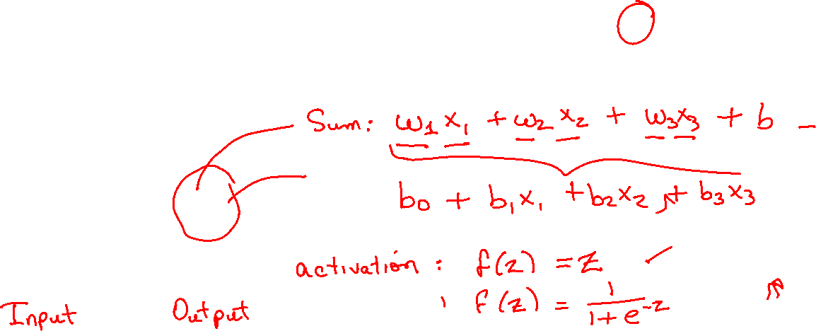
Neurons
Composed of a sum function and an activation function
SUM: performs linear function of inputs plus bias: $z=x^{⊤}w+b$
ACTIVATION: modifies the sum (usually non-linear): $f(z)$

Slide 5
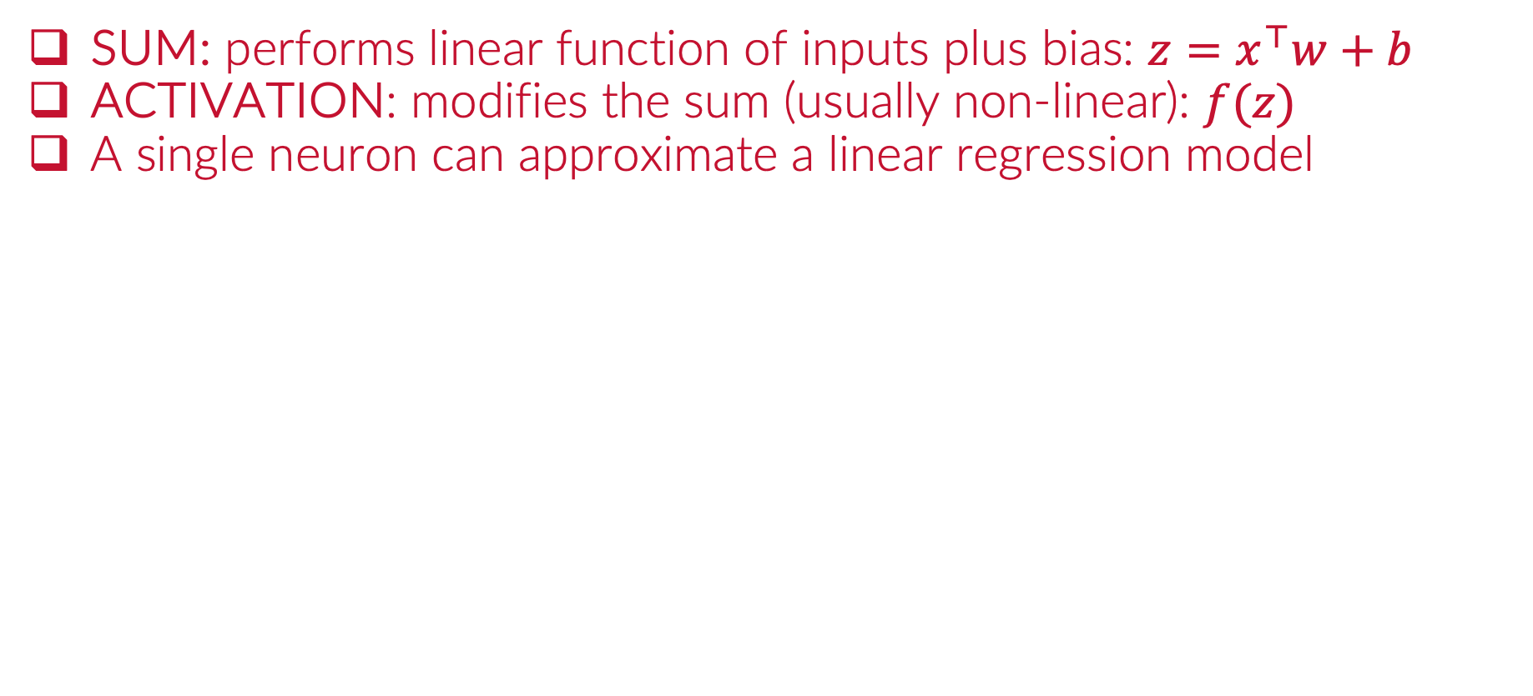
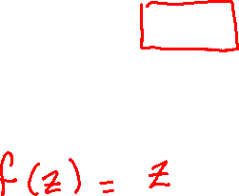
Neurons
SUM: performs linear function of inputs plus bias: $z=x^{⊤}w+b$
ACTIVATION: modifies the sum (usually non-linear): $f(z)$
A single neuron can approximate a linear regression model

Slide 6
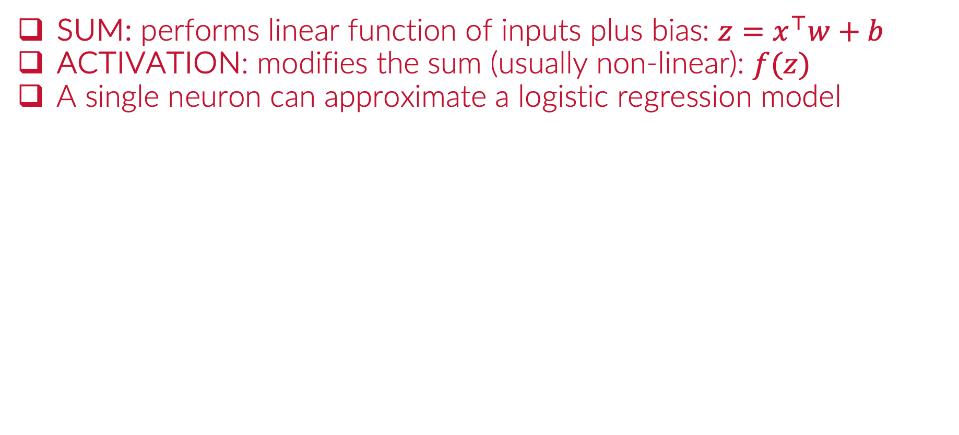
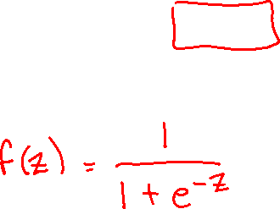
Neurons
SUM: performs linear function of inputs plus bias: $z=x^{⊤}w+b$
ACTIVATION: modifies the sum (usually non-linear): $f(z)$
A single neuron can approximate a logistic regression model

Slide 7
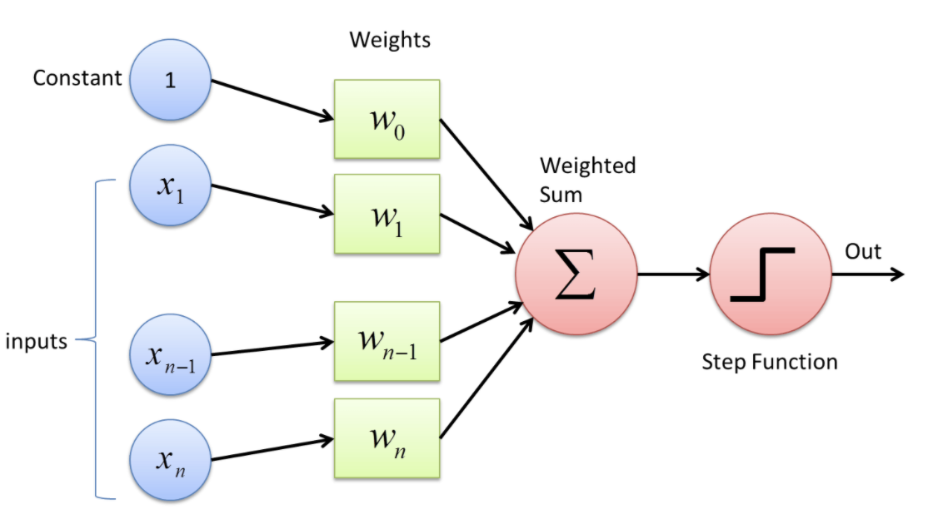
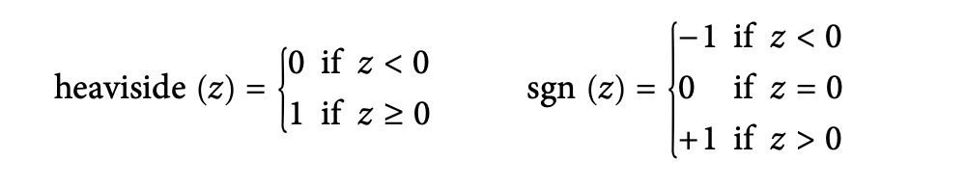
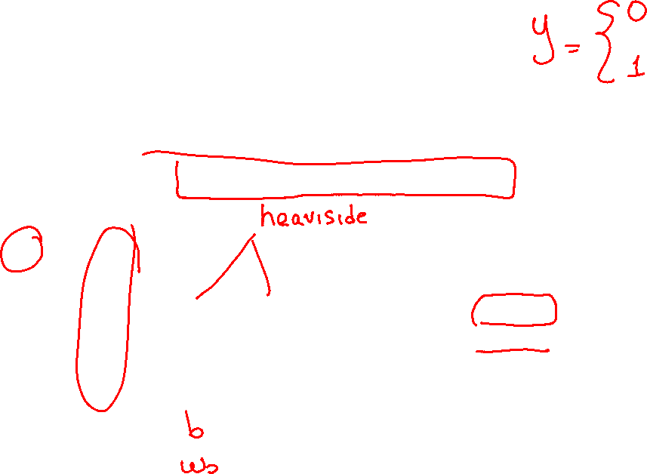
The Perceptron
The Perceptron is the most basic NN unit.
It contains a single unit (neuron)
Activation is a threshold logical unit (TLU).

Slide 8
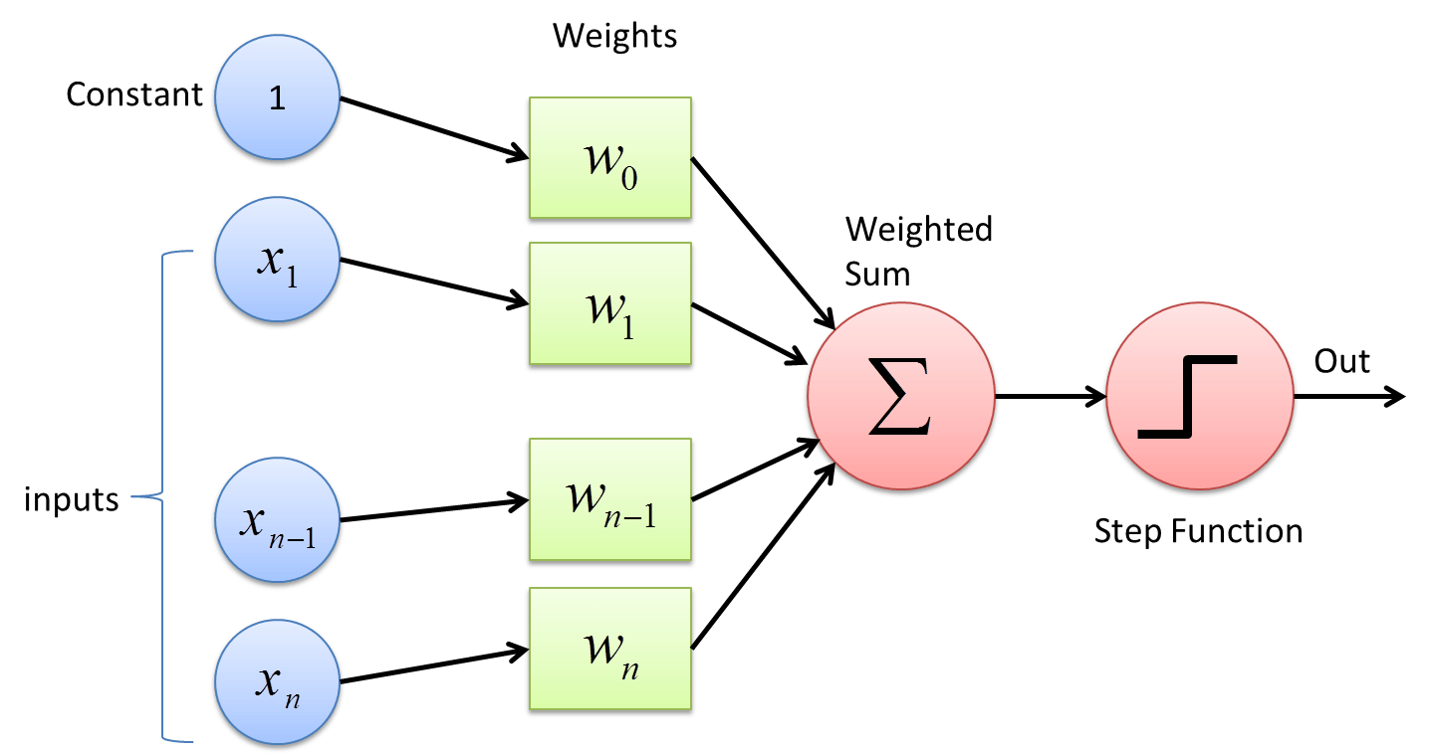
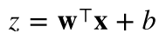

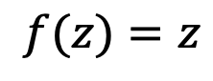
Linear Regression as a Perceptron
The chosen activation is would be “linear”
$$f(z)=z$$

Slide 9
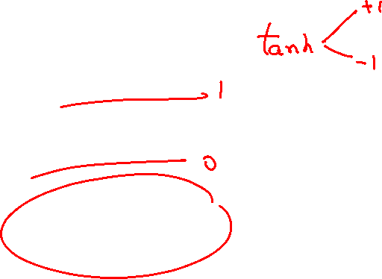
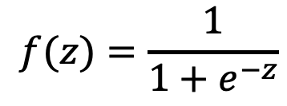
Logistic Regression as a Perceptron
The chosen activation is would be “sigmoid”
$$f(z)=\frac{1}{1+e^{−z}}$$

Slide 10
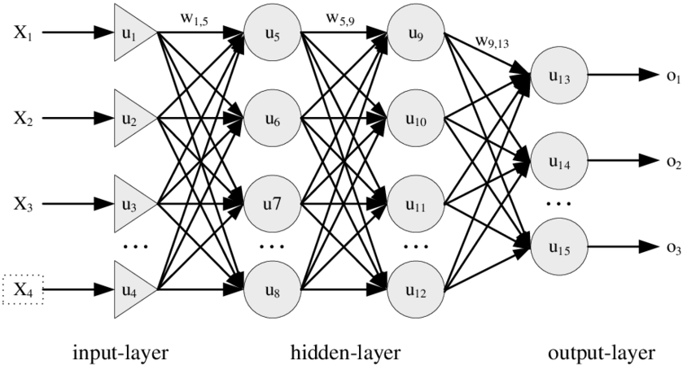
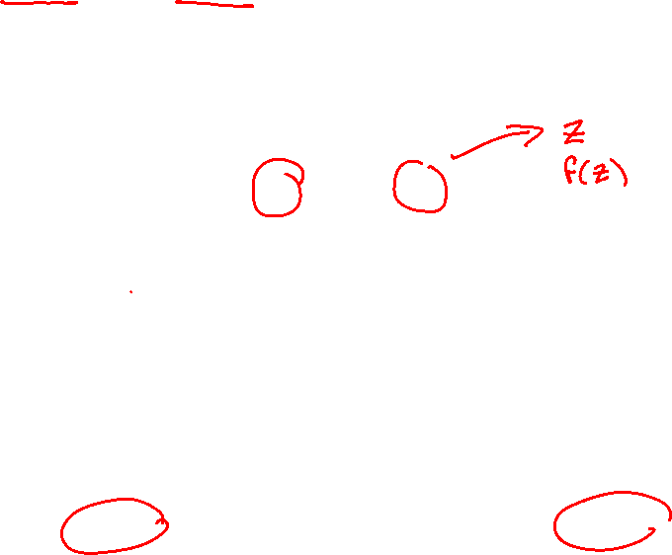
Multi-Layer Perceptron
Connect neurons in a forward approach

Slide 11
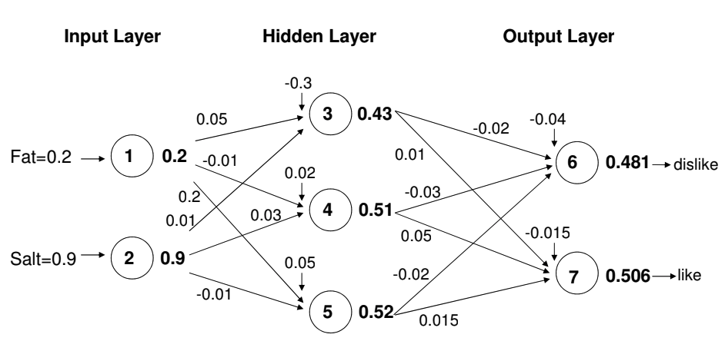

Multi-Layer Perceptron
Illustration (sigmoid): Input layer ▻ hidden layer ▻ output layer

Slide 12
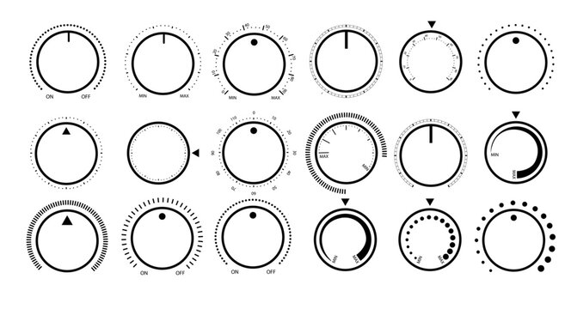

Multi-Layer Perceptron
Imagine each weight and bias is a knob we need to tune

Slide 13
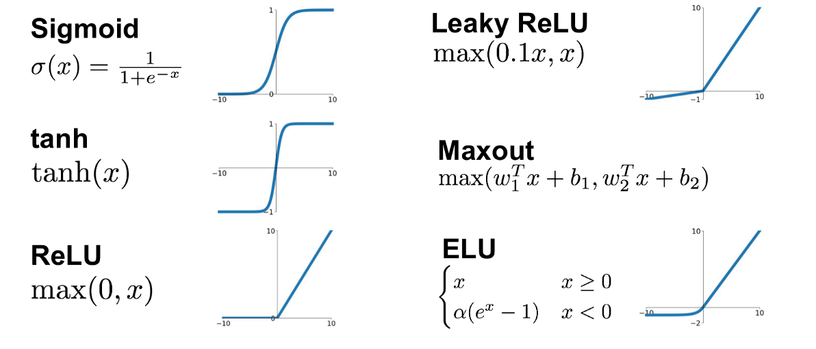

Common Activation Functions
We need activation functions with easily computable derivatives
Goal: amplify, lessen or cut the signal

Slide 14
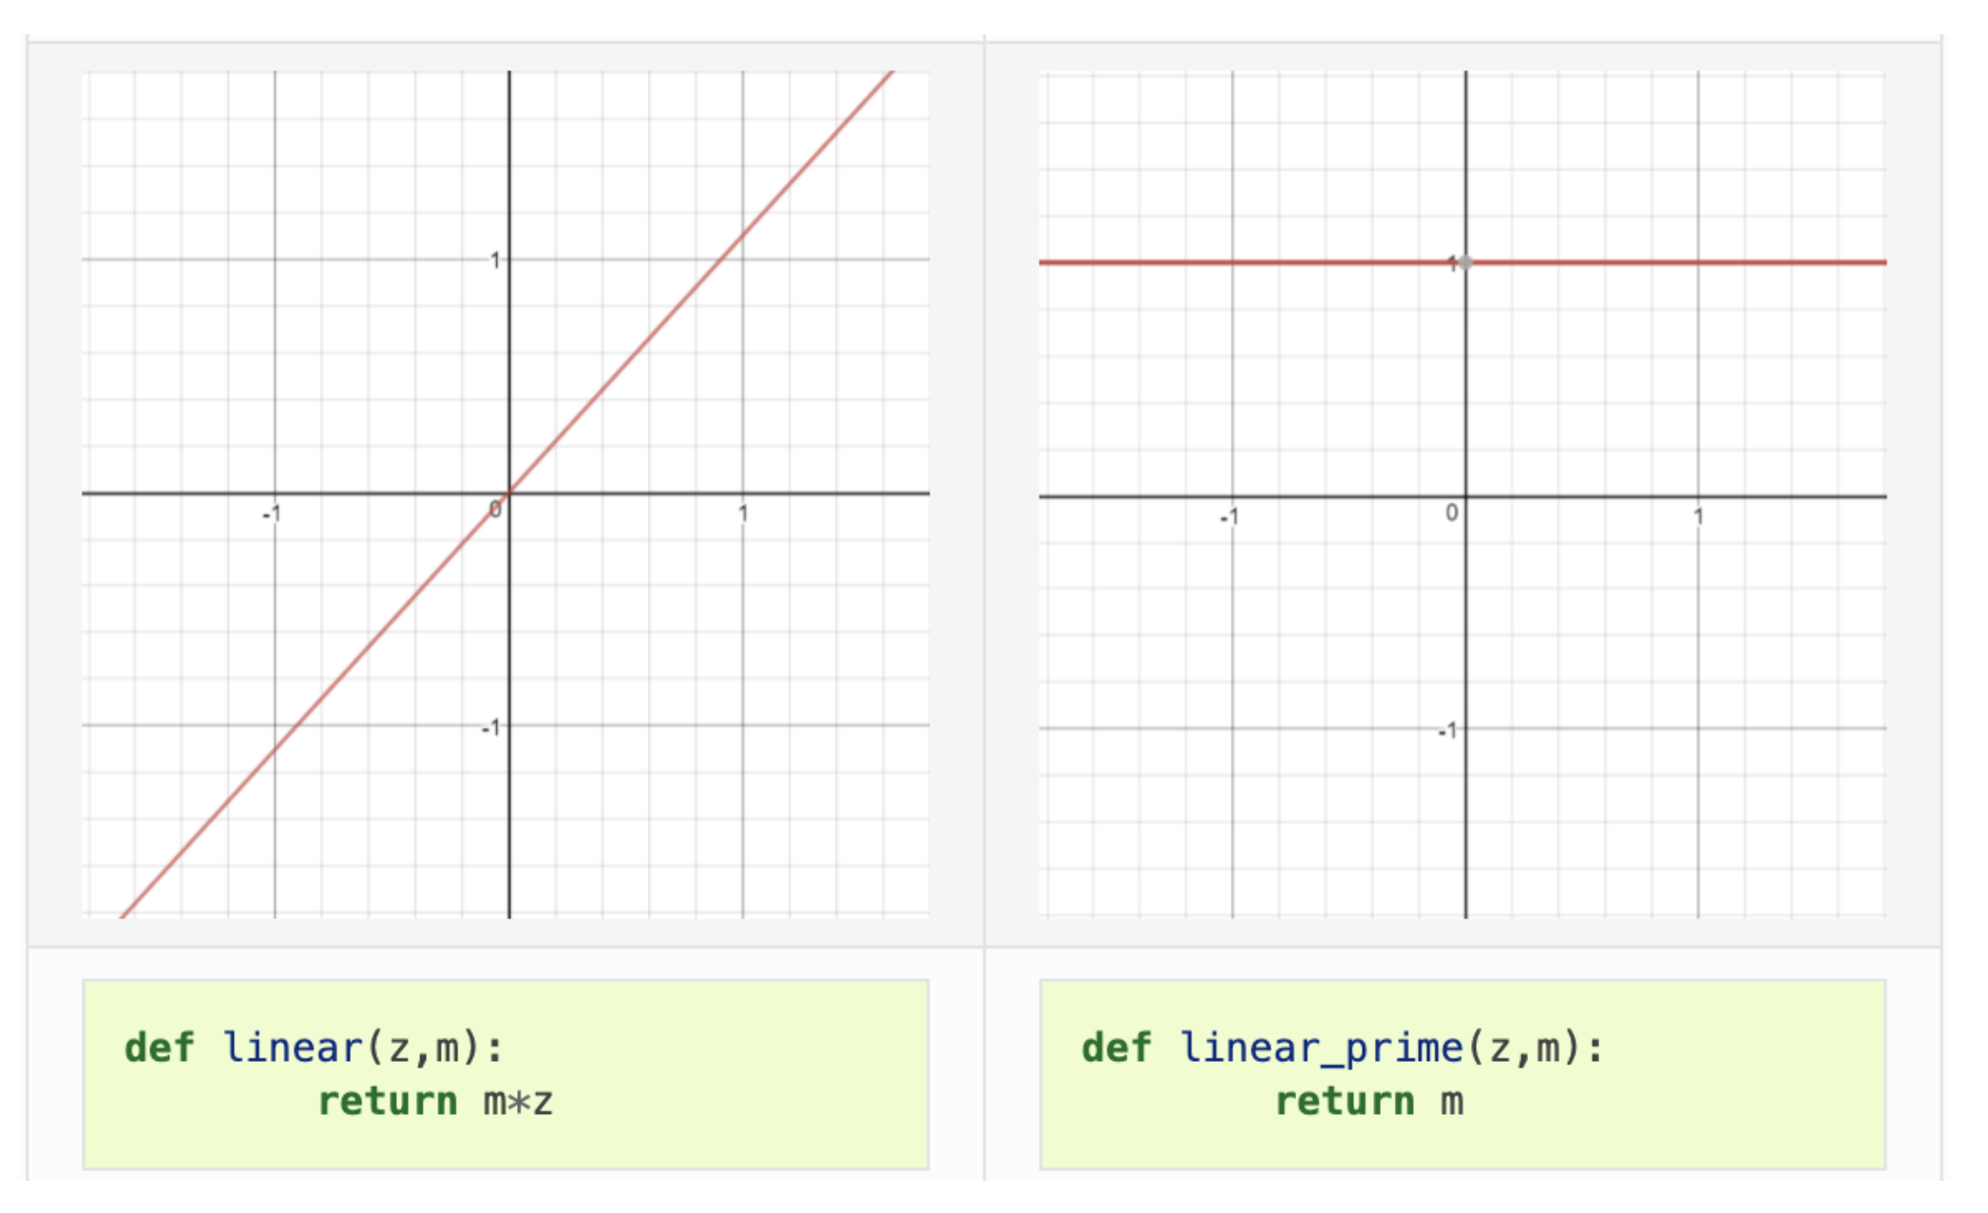
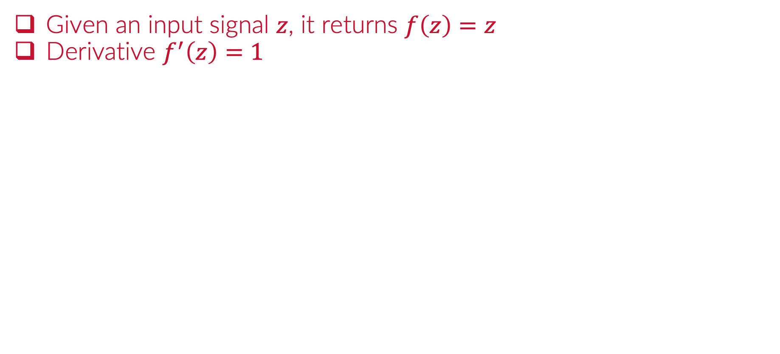

Activation: “linear”
Given an input signal $z$, it returns $f\left(z\right)=z$
Derivative $f^{′}\left(z\right)=1$

Slide 15
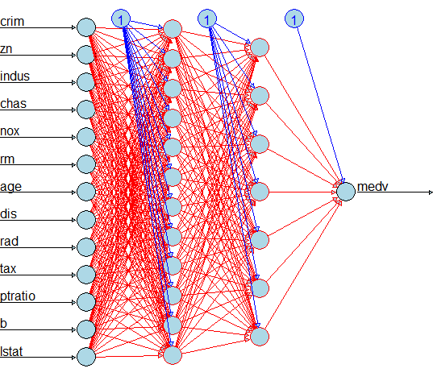
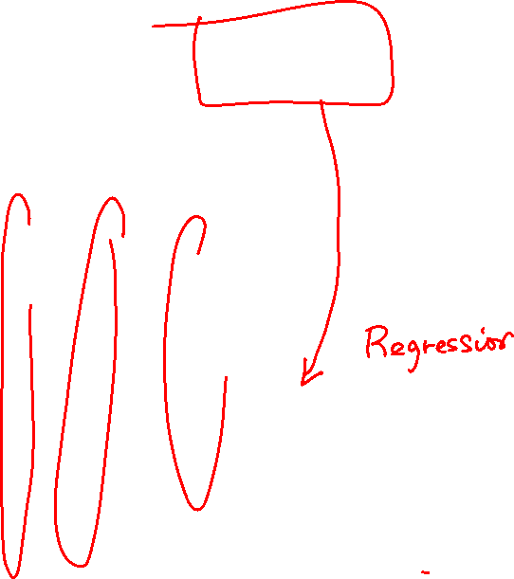
Activation: “linear”
Useful for the output layer (numeric response)

Slide 16
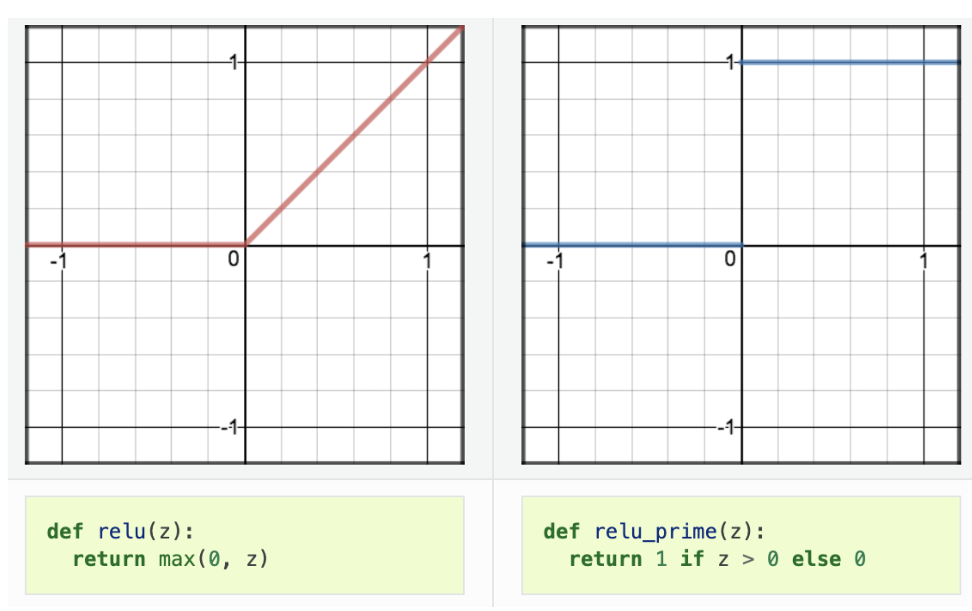
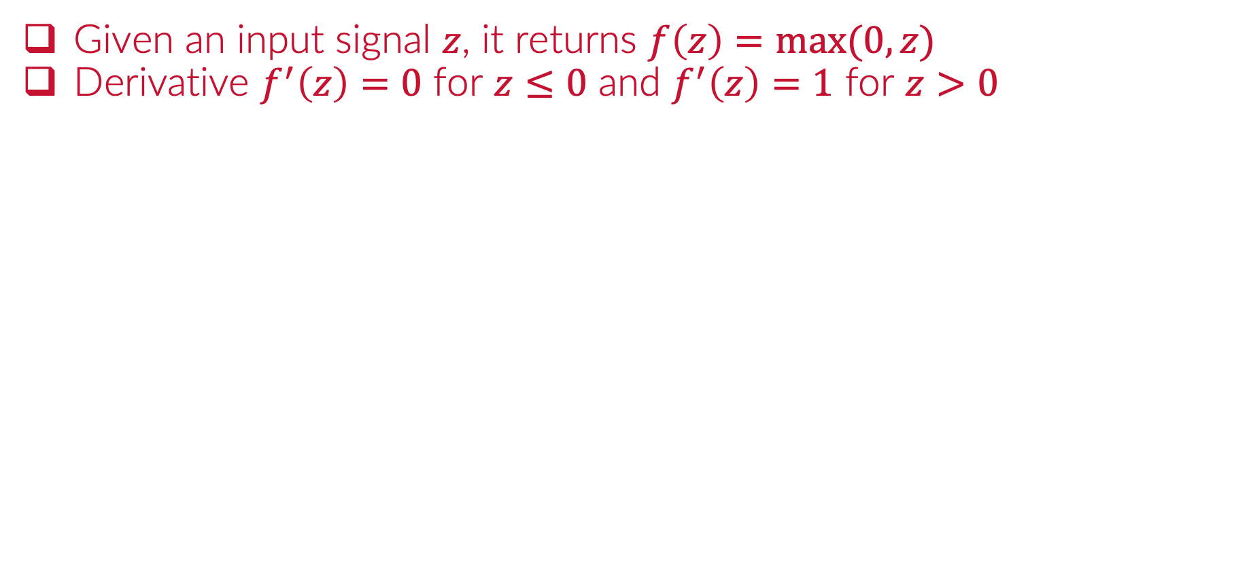

Activation: Rectified Linear Unit “ReLu”
Given an input signal $z$, it returns $f\left(z\right)=max⁡(0,z)$
Derivative $f^{′}\left(z\right)=0$ for $z≤0$ and $f^{′}\left(z\right)=1$ for $z>0$

Slide 17

Activation: “ReLu”
Useful for hidden layers and output layer (positive numeric)

Slide 18
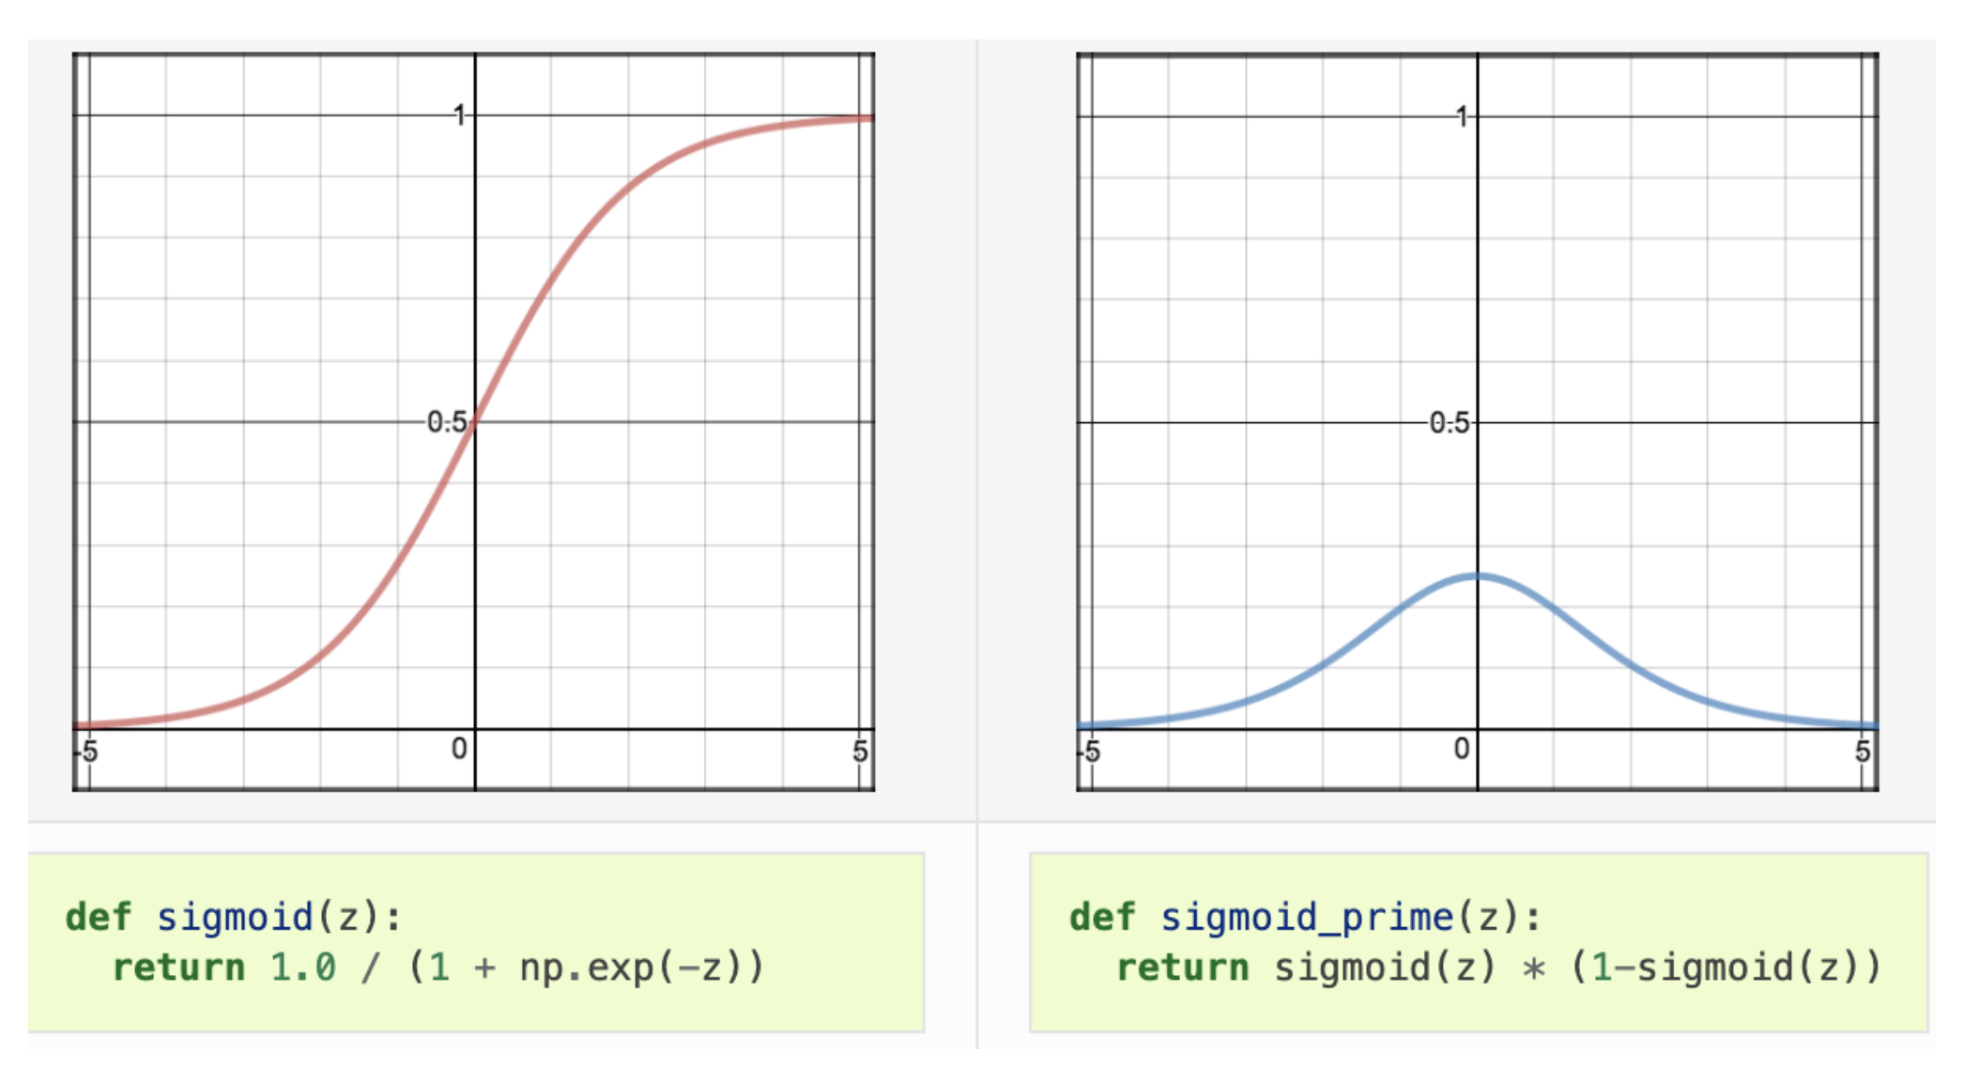
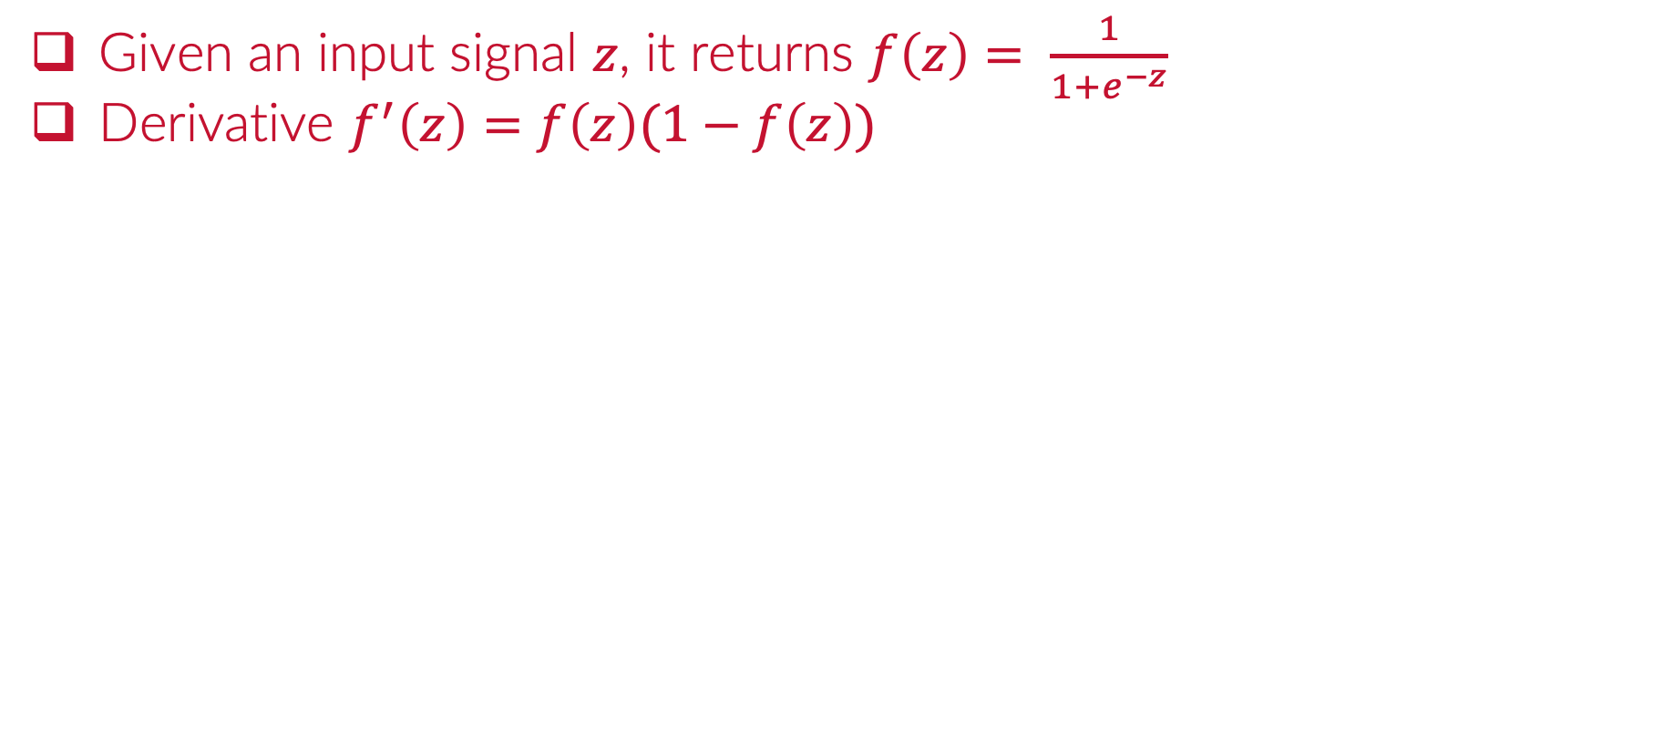
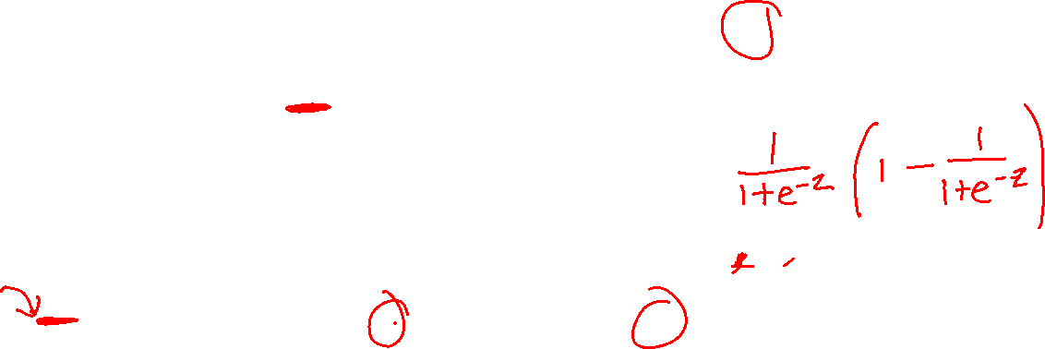
Activation: Sigmoid / Logistic
Given an input signal $z$, it returns $f\left(z\right)= \frac{1}{1+e^{−z}}$
Derivative $f^{′}\left(z\right)=f\left(z\right)(1−f\left(z\right))$

Slide 19
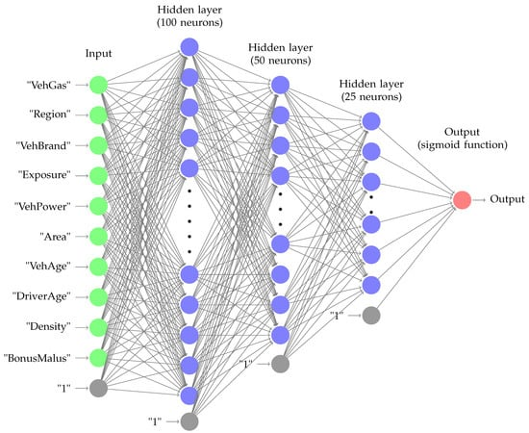

Activation: “Sigmoid”
Useful for hidden layers and output layer (binary response)

Slide 20
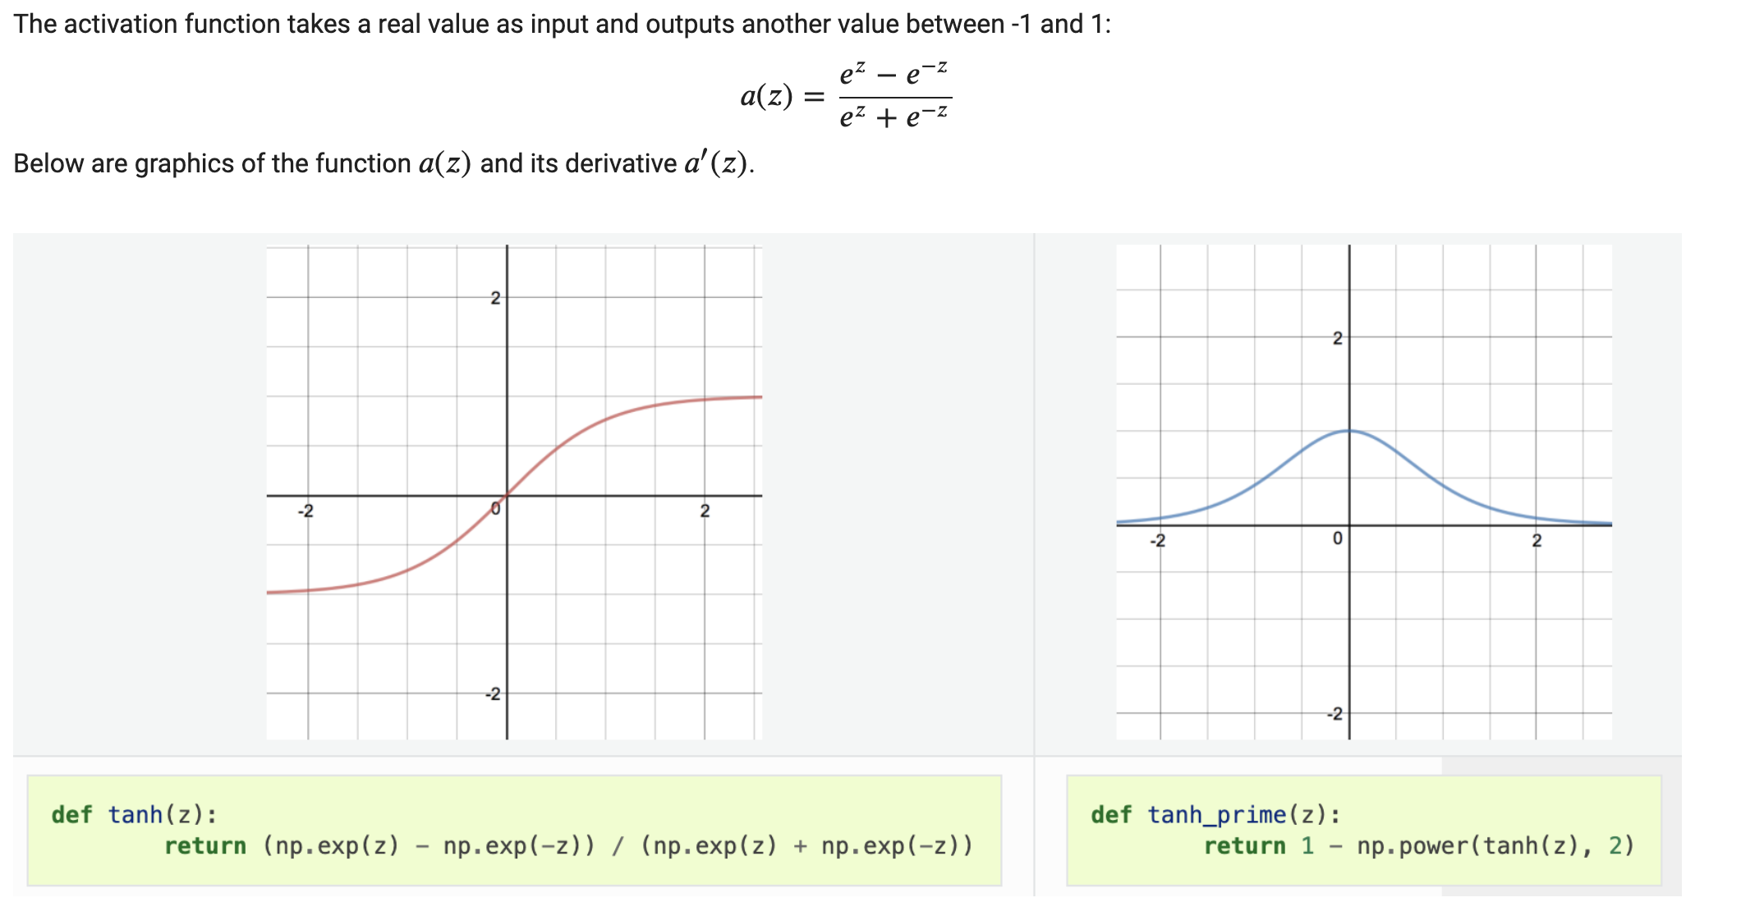
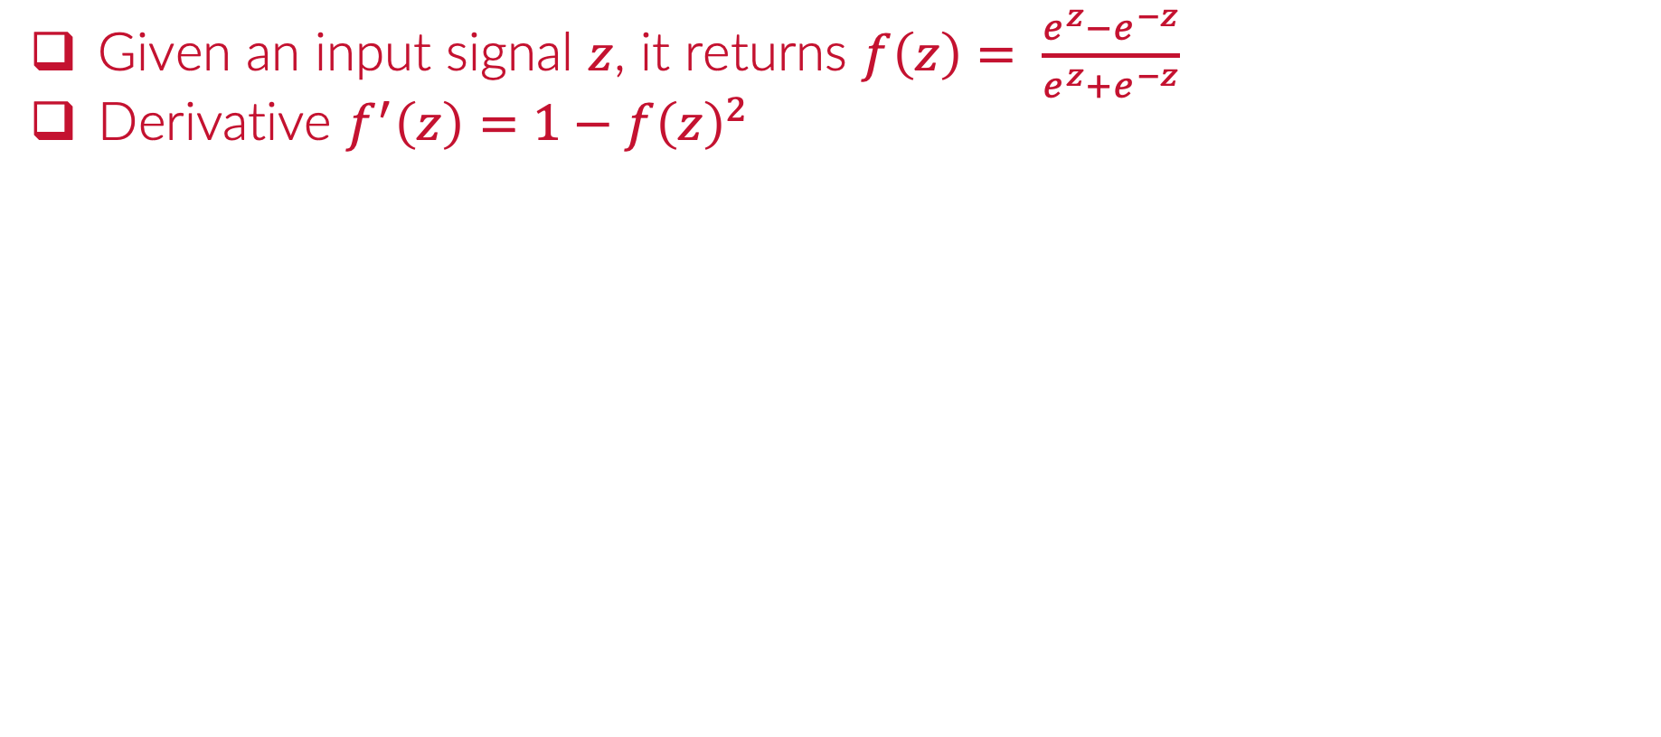
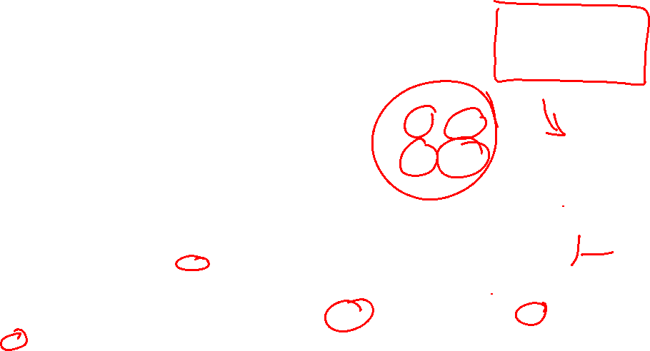
Activation: hyperbolic tangent ”tanh”
Given an input signal $z$, it returns $f\left(z\right)= \frac{e^{z}−e^{−z}}{e^{z}+e^{−z}}$
Derivative $f^{′}\left(z\right)=1−f{\left(z\right)}^{2}$

Slide 21
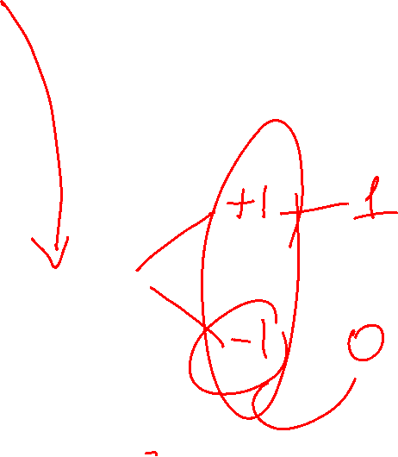
Activation: “tanh”
Useful for hidden layers and output layer (binary response)

Slide 22

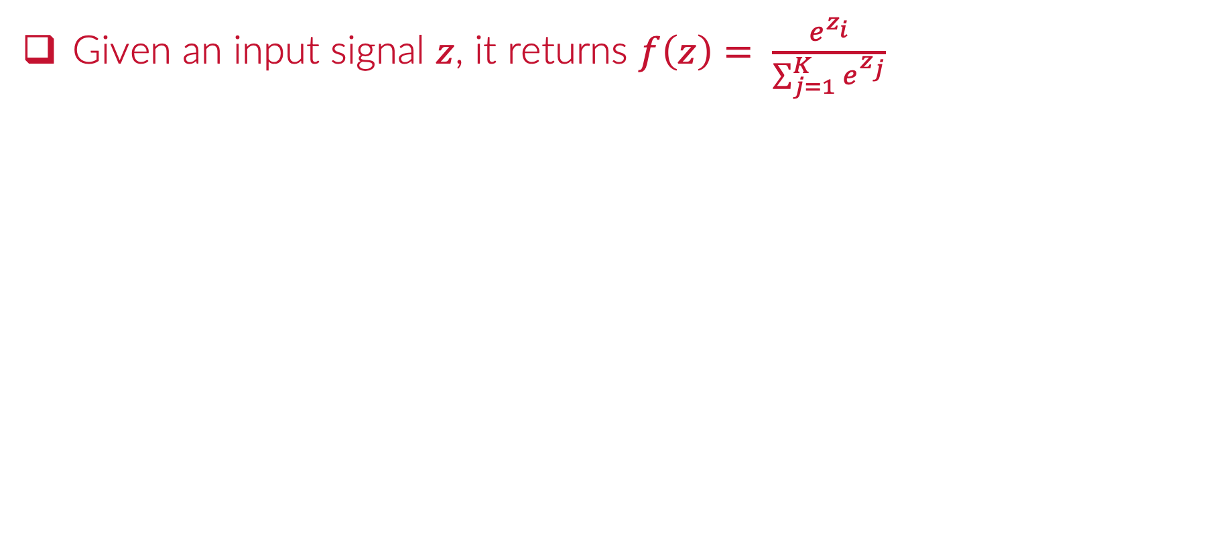
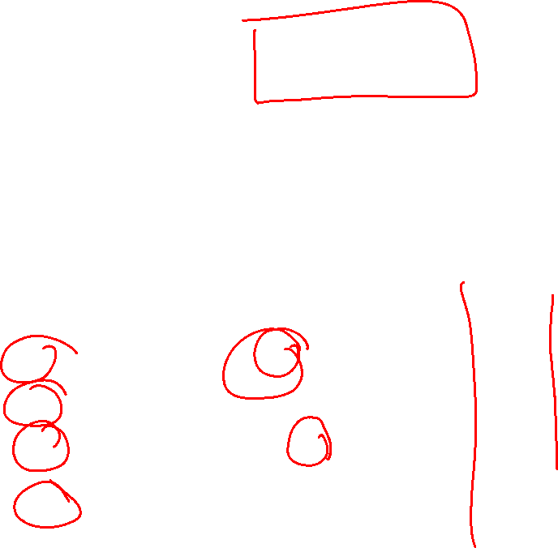
Activation: ”softmax”
Given an input signal $z$, it returns $f\left(z\right)= \frac{e^{z_{i}}}{\sum_{j=1}^{K}{e^{z_{j}}}}$

Slide 23
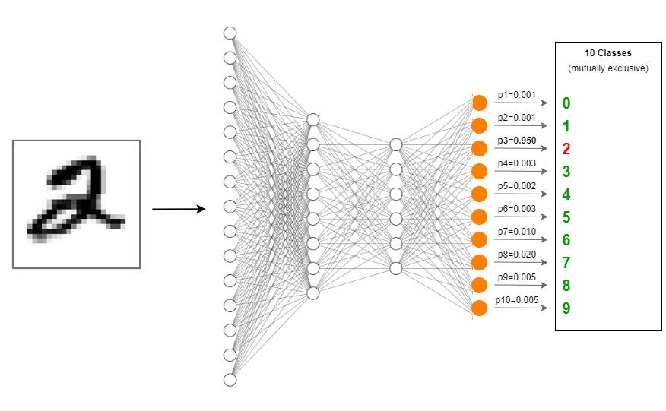

Activation: “softmax”
Useful for output layer (multi-class response)

Slide 24
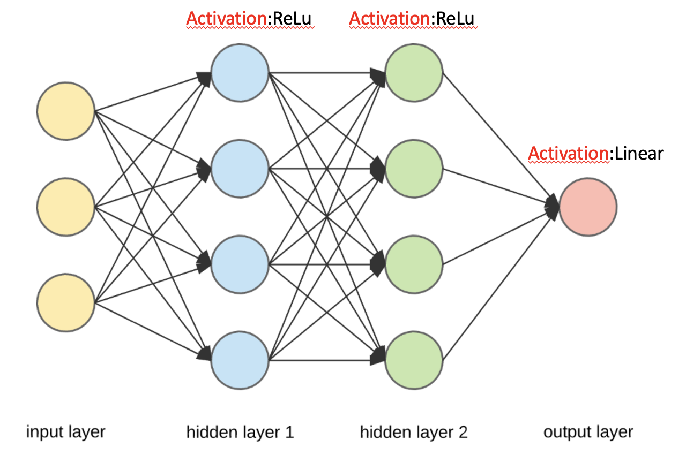
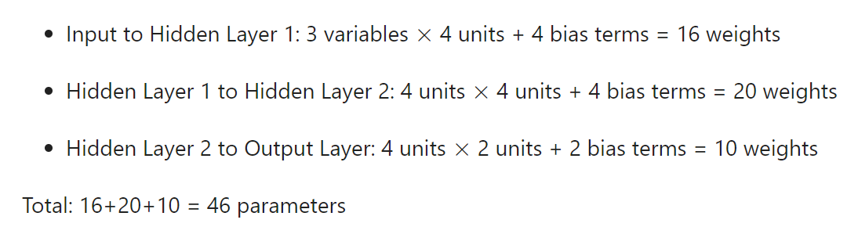
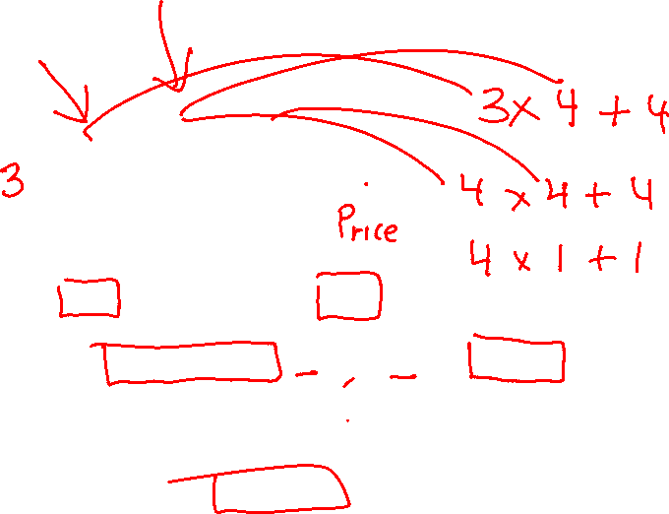
Number of Estimated Parameters
Useful to know when we might overfit

Slide 25
Python
Notes:
Guidelines
Use a title slide at the beginning of your presentation. There are 9 variations of title slides to choose from.
If you will have a series of slideshows, we recommend using the same style of title slide for each presentation.
Keep your title to no more than 2 lines.
Do not change the font style or font size of the title or subtitle.

